Slide 1

Introduction to MS SQL Server 2005
Iliyan Murdanliev
National Academy for Software Development
academy.devbg.org

Slide 2

Contents
Basic knowledge
  Services
  Types of databases
  Authentication and permissions
  SQL Server Management Studio Express
Moving a database
  Through backups and restore
  By detaching and attaching

Slide 3
MS SQL Server 2005
Basic Knowledge

Slide 4
What is Microsoft SQL Server
Relational Database Management System – RDBMS
The main language that is supported is Transact SQL (T-SQL)
There is a free distribution
http://www.microsoft.com/sql/editions/express/default.mspx
The most recent version is 2008
Works only on Windows systems

Slide 5
Services in SQL Server 2005
Sqlservr – database engine
  Processes T-SQL queries
  Distributes resources to the clients
  Ensures database integrity
SQLServerAgent
  Gets information for the processes' state
  Creates schedules and automates managing of tasks
  Can send email or other massage if a problem arises

Slide 6
Services in SQL Server 2005
Distributed Transaction Coordinator (MS DTC)
  Permits client applications to include several different sources of data in one transaction
  Coordinates committing the distributed transaction across all the servers that are enlisted in the transaction

Slide 7
SQL Server Databases

Slide 8
Types of Databases
System databases
  Maintain information for MS SQL Server as a system
User databases
  Databases created by a user
  They use the system databases internally

Slide 9

Types of Databases
System Databases
master
model
tempdb
msdb
distribution
pubs
Northwind
User1
User Databases

Slide 10
System Databases
Master – meta database. Stores data for:
  User accounts
  Configurable environment variables
  System error messages
Model – a prototype for new databases
Tempdb – buffer memory for temporary database objects
MSdb – buffer memory for history – schedules and tasks

Slide 11
SQL Server Databases
Each database consists of 2 files:
  .mdf file – a file that contains all the data in the database
  .ldf file – a file that keeps track of transactions, logs and so on
You need both of them to use the database

Slide 12
SQL Server Authentication

Slide 13
Connecting to SQL Server
We need to know
  The name of the server
  The name of the database
  Username/password (if using SQL Server authentication)
Types of authentication in SQL Server
  Windows (by using a Windows user credentials)
  Mixed (both Windows and SQL Server)

Slide 14
SQL Server Users Permissions
Each user has certain permissions and roles for a database (Database User Account)
A role defines a group of users with the same permissions
There are 3 types of roles in MS SQL Server
  Fixed server roles
  Fixed database roles
  User-defined database roles

Slide 15
Fixed Database Roles
Public - maintain all default permissions for users in a database
Db_owner - Perform any database role activity
Db_accessadmin - Add or remove database users, groups, and roles
Db_ddladmin - Add, modify, or drop database objects
Db_securityadmin - Assign statement and object permissions
Others…

Slide 16
SQL Server Management Studio
A Powerful Management Tool for Administrators and Developers

Slide 17
SQL Server Management Studio Express
SQL Server Management Studio Express (SSMSE) is a Microsoft graphical database management tool
  Free
  Easy to use
  Works only with SQL Server 2005 and SQL Server 2005 Express Edition
  Free download from:
  http://www.microsoft.com/downloads/details.aspx?FamilyId=C243A5AE-4BD1-4E3D-94B8-5A0F62BF7796&displaylang=en

Slide 18
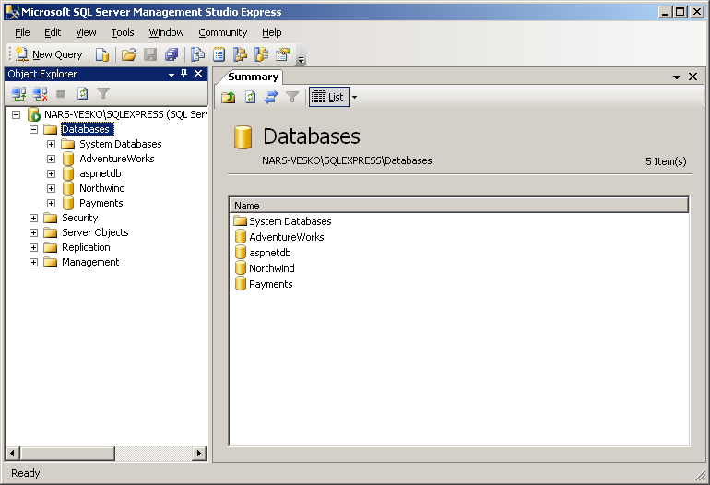
SQL Server Management Studio Express

Slide 19
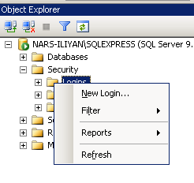
SSMSE Setting Server Account
You can use SSMSE to give permission to users
Follow these steps:
  First select the security folder in Object Explorer and right click the Logins folder
    Choose "New Login…"

Slide 20
SSMSE Setting Server Account (2)
In the following dialog click the search button
  Select one of the windows account in a typical Windows fashion
  Leave the authentication method set to Windows authentication
  Click "OK"
In this way you create an SQL Server User account
Later you can set database permissions for this account

Slide 21
SSMSE Setting Database Account
Right click on the "Security" directory under some of the databases and choose "New" → "User"
Set the username you want and select one of the Server accounts to use
Set the roles for this user
Click "Ok" to confirm
By selecting the name_of_database → properties → permissions you can also set specific permissions for the accounts

Slide 22
Setting Account Permissions
Live Demo

Slide 23
SQL Server Management Studio Express
It can be used to visually change the structure or data in a database
It can execute T-SQL queries
  Select the database you want to work with in the Object Explorer
  Click the [New Query] button just under the file menu
  Write the query in the window to the right of Object Explorer
  Click the [Execute] button

Slide 24
Executing a Simple SQL Query
Live Demo

Slide 25
Moving an SQL Server 2005 Database

Slide 26
Moving a Database
Necessary when we install a certain application at the customer environment
Ways of moving an SQL Server database:
  By means of backup and restore
  By detaching and attaching the database
    The 2 servers must have the same versions!
Notes:
<number>##
<footer>*
<header>*

Slide 27
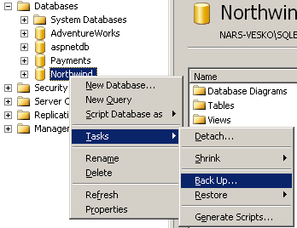
Moving by Backup and Restore
We back up the database through SQL Server 2005 Management Studio
Transport the backup to the receiving server

Slide 28
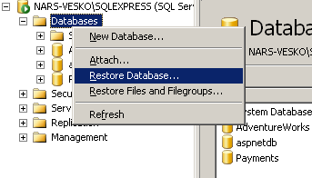
Moving by Backup and Restore
Again by using SQL Server 2005 Management Studio restore the database

Slide 29
Moving by Detaching and Attaching
On the source server:
  Choose the database in SQL Server Management Studio
  From the context menu we choose the Detach command
We copy the database files from the source server to the destination server. As mentioned files have the following extensions :
  <database_name>.mdf

Slide 30
Moving by Detaching and Attaching (2)
  < database_name_log>.ldf
We attach the database on the destination server with the Attach command in SQL Server Management Studio

Slide 31
Moving a Database by Detaching and Attaching
Live Demo

Slide 32
Introduction to MS SQL Server 2005
Questions?

Slide 33
Exercises
Connect to the SQL Server with SQL Server Management Studio. Use Windows authentication.
Create a new database Pubs and create new user for connecting to it. Execute the script Pubs.sql to fill the database data.
Attach the database Northwind (use the files Northwind.mdf and Northwind.ldf) to
SQL Server and connect to it.

Slide 34
Exercises
Download and Install SQL Server Express at home.
Download and Install SQL Server Management Studio at home.

